Slide 1



Academy Changes
Effective April 2021
Thank you to all parents and carers who participated in the consultation process, your input is highly valued. The consultation process came to an official close on Friday 19th March 2021. Having consulted with the Chief Executive Offer at Academy Transformation Trust, our Board of Trustees, our Local Academy Committee (LAC), all staff and members of the local community – including the local authority and unions, I am now in a position to announce that the outlined proposal will commence as a pilot in the first instance, for 1 term, commencing the week beginning the 19th April (after Easter).
As stated in the initial consultation, the DFE recommended face to face teaching time is 25hrs per week, the new model will see 26.5hrs per week, exceeding the current recommendations.

Slide 2



Staggered Start Times

Slide 3


Staggered Finish Times
Effective the week beginning the 19th April

Slide 4
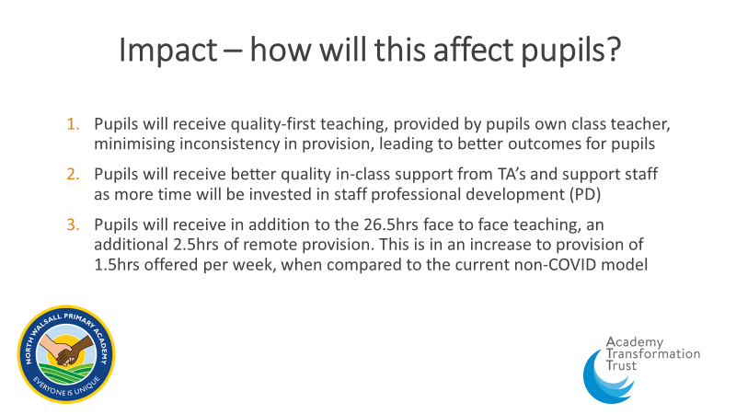

Slide 5

Remote Provision
During a Friday afternoon, children will have the opportunity to learn remotely. A remote offer will be provided on a weekly basis, consisting of 2.5hrs of educational provision.
Although this provision is optional it is highly recommended as it will enable all pupils to further their learning through a range of digital platforms and practical activities. If you have issues with access to a digital device from home, contact the school and inform Mrs Smith and the school will look into how best we can support.

Slide 6
Working Family Provision
For our working parents whereby both parents work or in the case of single parent families the sole parent works, on-site provision on a Friday afternoon is available.
We are asking parents who qualify for this provision to contact Mrs. A Smith in the school office between Tuesday 23rd March and Wednesday 31st March to discuss eligibility and providing proof of work. Places in provision will only be provided once sufficient evidence of work has been provided. Mrs Smith will discuss in detail what evidence is acceptable and how this needs to be submitted. Evidence submitted after the 31st March cannot be reviewed and a place in onsite provision during the first week back after half term will not be granted and will need to be reviewed at a later date.
There will be no exception to this rule, as risk assessments to ensure COVID guidance is adhered to will need to be drawn up in advance.

Slide 7
Post COVID Restrictions
Once we are in a position as a school to move away from the COVID restrictions and safeguarding measures of staggered start and finish times, we will move to the new start and finish times of 8.45am start for all year groups, with nursery at 8.30am; with a return to the 3.15pm finish time, with a finish time of 12.45pm on a Friday.
We review our COVID risk assessments every half term so it is likely that the staggered start and finish times may remain in place to the end of this academic year.
As the model is in the first instance a pilot, it will be review after a term. Throughout this time, we will continue to seek the views of all stakeholders such as parents, pupils and staff to evaluate the success and impact of the model, before moving to make any permanent change.

